Slide 1
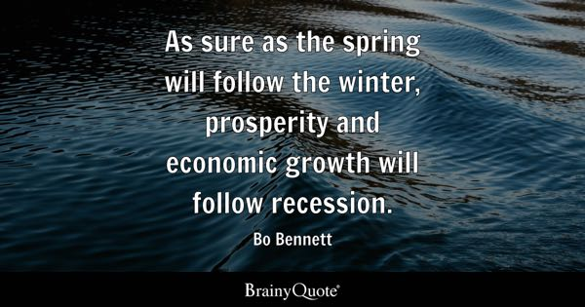

Slide 2
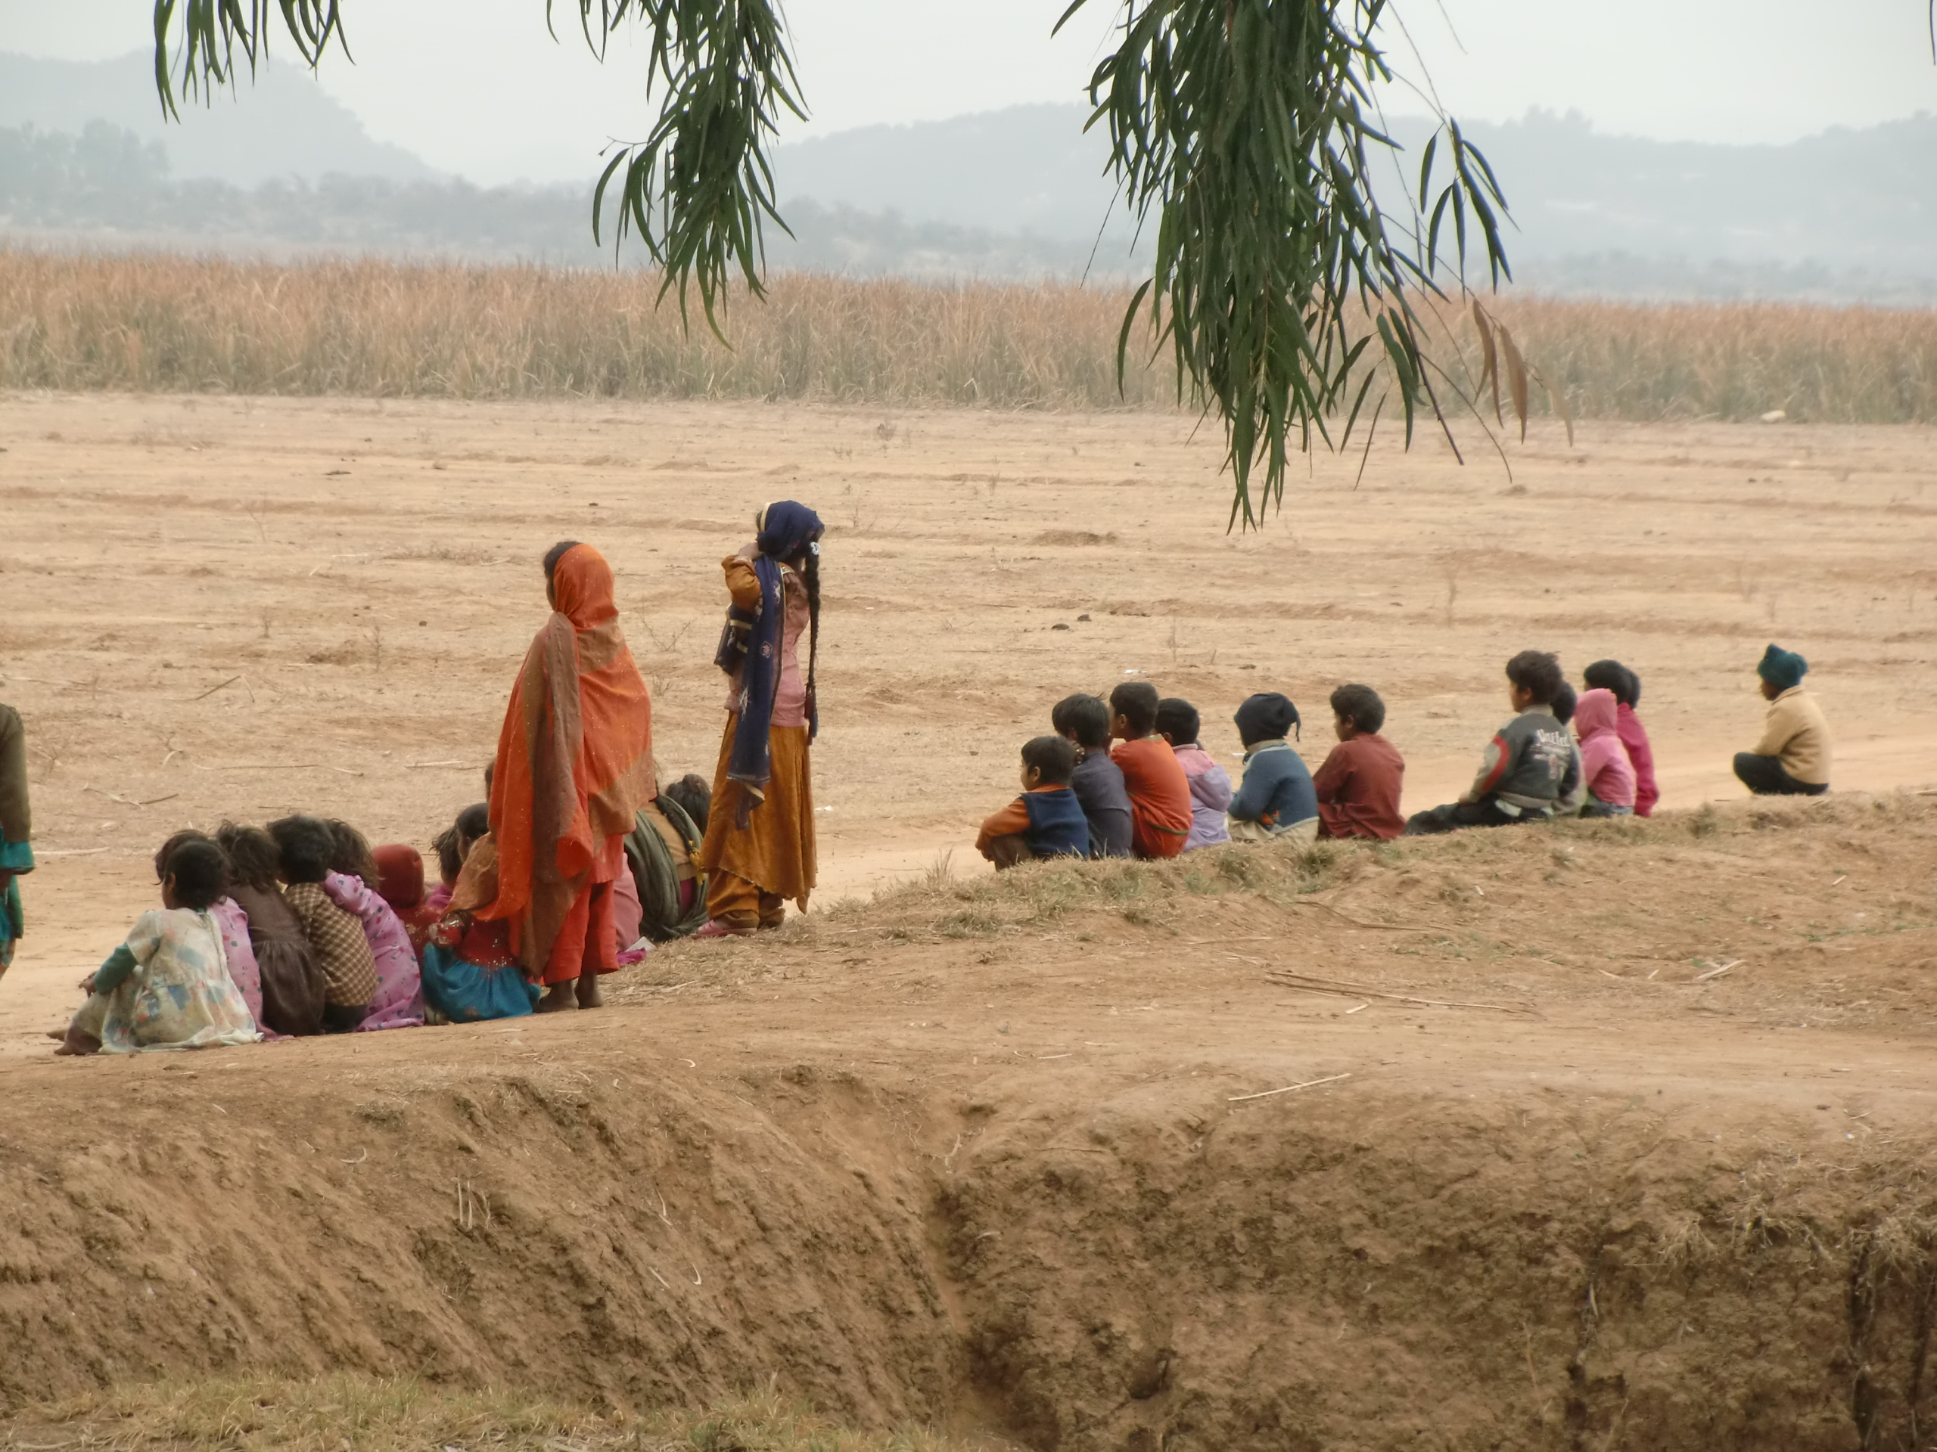
HOW TO OVERCOME ECONOMICAL ISSUES IN PAKISTAN.
PRESENTED BY GHULAM MUSTAFA.

Slide 3
CONTENT.
INTRODUCTION OF ECONOMY.
ECONOMICAL ISSUES OF PAKISTAN.
SOLUTION OF ECONOMICAL ISSUES OF PAKISTAN.

Slide 4

ECONOMY
PRODUCTION OF GOODS.
CONSUMPTION OF GOODS.
EXCHANGE OF GOODS AND SERVICES.

Slide 5

ECONOMICAL ISSUES OF PAKISTAN.
PAKISTAN IS IN DEBT TRAP.
POLITICAL INTEREFERENCE.
INFLATION.

Slide 6
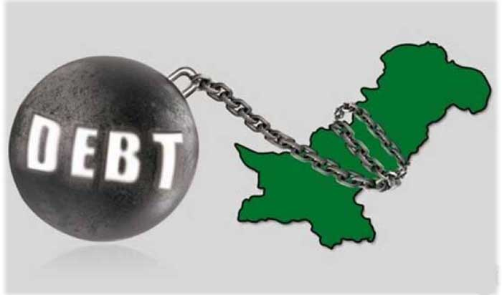
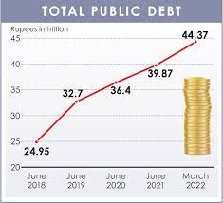
PAKISTAN IS IN DEBT TRAP.
THE LOAN WHICH HAS TAKEN FOR RUNNING THE COUNTRY.

Slide 7
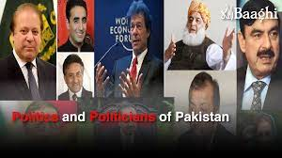
POLITICAL INTEREFERENCE.
HAVING NOT PROPER POLITICS, IT EFFECTS BADLY ON ECONOMICS.

Slide 8

INFLATION.
DECERASING OF EXPORT AND INCREASING OF IMPORT.

Slide 9

SOLUTION OF ECONOMICAL ISSUES OF PAKISTAN.
DECREASE IN CORRUPTION.
INCREASE PRODUCTION OF AGRICULTURAL GOODS.
BUILT MORE INDUSTRIES.
DECREASE POVERTY.
WOMEN EDUCATION.

Slide 10
THANKS!!

